Slide 1
Delinking Land Rights from Land Use: Certification and Migration in Mexico
De Janvry, Emerick, Gonzalez-Navarro and Sadoulet

Slide 2
Existing literature on titling
Has not considered spatial allocation of labor and migration effects
This could be important given the extremelylow productivity of labor in rural areas
Can titling improve efficiency of labor allocation?
Mexico has especially low labor productivity in the rural areas and also a titling program PROCEDE on land previousll ejidal with user rights
Finding: use three data sets to show that titling increased out-migration especially in the first titled farm areas, farm sizes increased due to transactions. It also increased consumption. This not due to attraction of credit.

Slide 3
Land Reforms and certification in Mexico
After Mexican Revolution , Govt. expropriated large plantations and allocated them to groups of farmers ejidos with useifruct rights.
Certification procedeed in waves starting in 1993 and completed in 2006

Slide 4
Certification Effect on Migration
Y_{ijt} = Certif_{jt} + γ_{j} +α_{t} + βx_{ijt} +ε_{ijt}
Popjt = γ_{j} =β Year 2000t +
δCertified 1993-99*Year 2000 + ε_{ijt}
Also distinguish between early and late certified. Also controls for ex ante level of property rights insecurity , initial farm size , land quality
Does this both at locality level, and ejido level
Also analyze Effects on land area and land area per farmer
Finally impact on Household Consumption

Slide 5
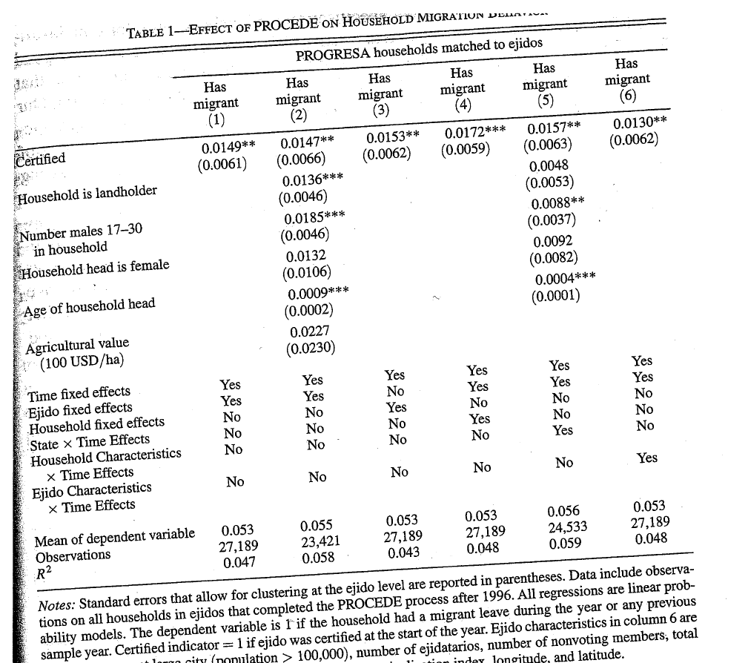

Slide 6
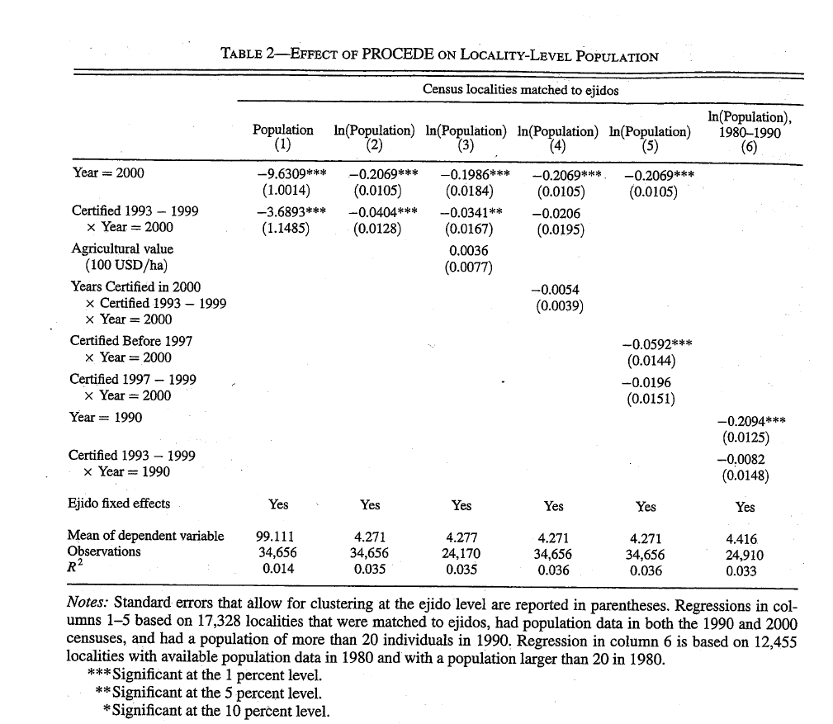

Slide 7
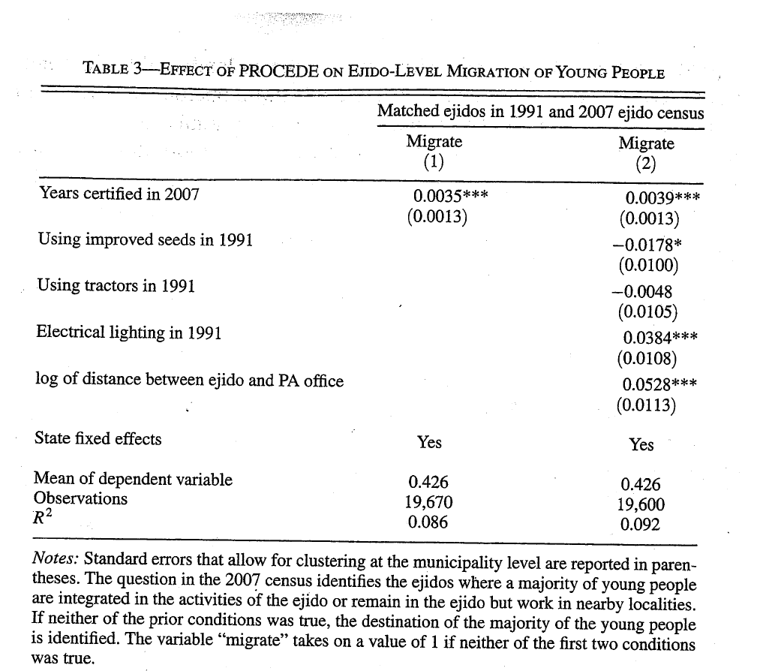

Slide 8
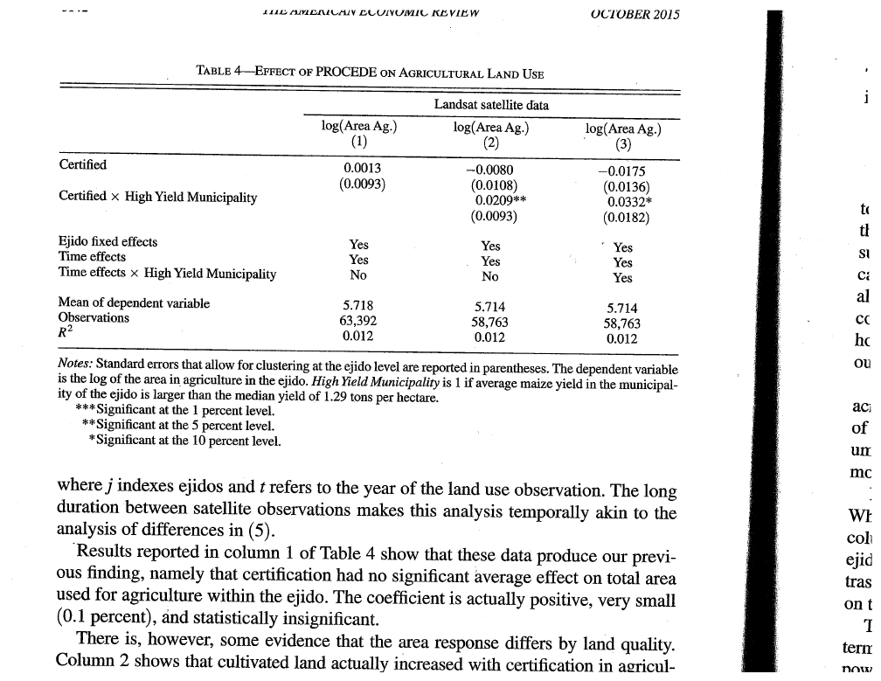

Slide 9
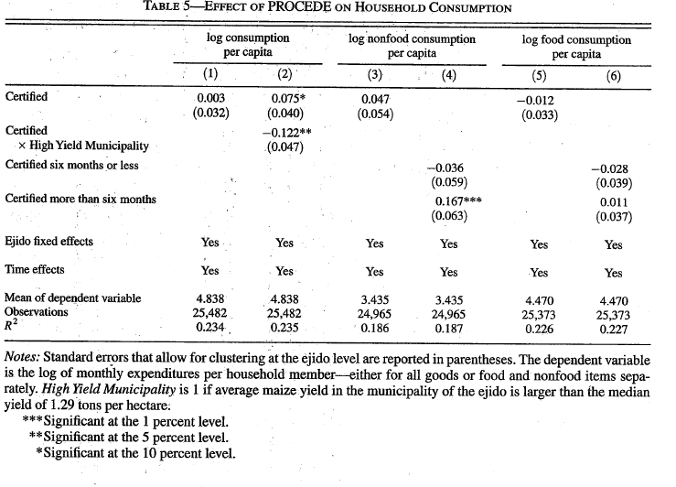

Slide 10
Other Concerns
if Pre-program trends in migration PROCEDE carry-out were correlated
Attrition bias Tested for robustness by excluding those houeshold interviewed in 1998 but not in 1999 or 2000
What about pre-program trends in agricultural productivity or availability of new seeds?

Slide 11
Policy Implications
Land titling delinking from land use rights effects of types other than increased investment may be important
Allowing for reduction in labor per unit of land through out migrtaion
Allowing farm size to change through land transactions without reducing the use of land in cultivation.
Can generate true welfare gains

